Slide 1

ADM24DN003 – Organic Kundapura
Varun M (2321982)
Programmer Analyst Trainee

Slide 2

Abstract
The "Organic Kundapura Store" is a virtual marketplace that brings together farmers from Kundapura and nearby villages, offering a diverse range of organic products. It fosters community-driven agriculture by eliminating intermediaries, thus preserving Kundapura's natural heritage. More than a marketplace, it's a movement towards sustainable living, supporting local farmers and promoting environmental sustainability. It's a harmonious blend of commerce, community, and environmental consciousness.
2

Slide 3
Project Modules
Green Directory (Product Catalogue):
This module serves as a digital showcase of the organic products available. It provides customers with an easy-to-navigate platform to browse, search, and filter through the diverse range of organic offerings.
Eco-Basket:
This module acts as a virtual basket for customers to gather their chosen organic products. It manages product quantities and calculates the total cost, facilitating a seamless shopping experience.
Safe Trade:
This module ensures secure financial transactions. It integrates with a reliable payment gateway, offering customers a variety of payment methods for their convenience.

Slide 4
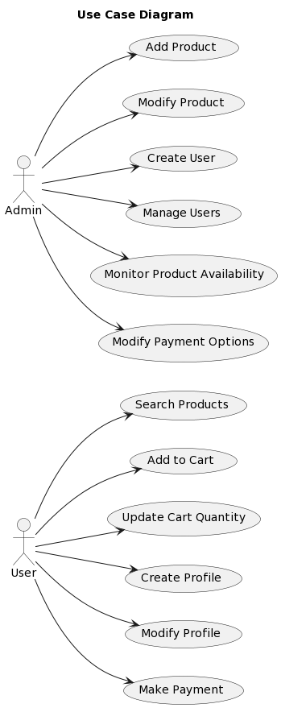
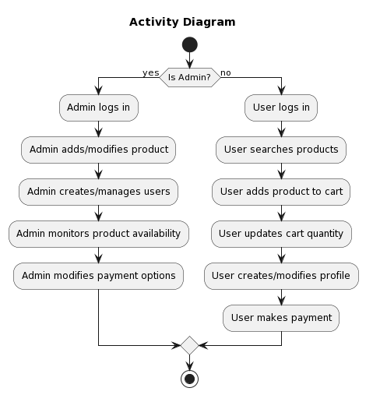
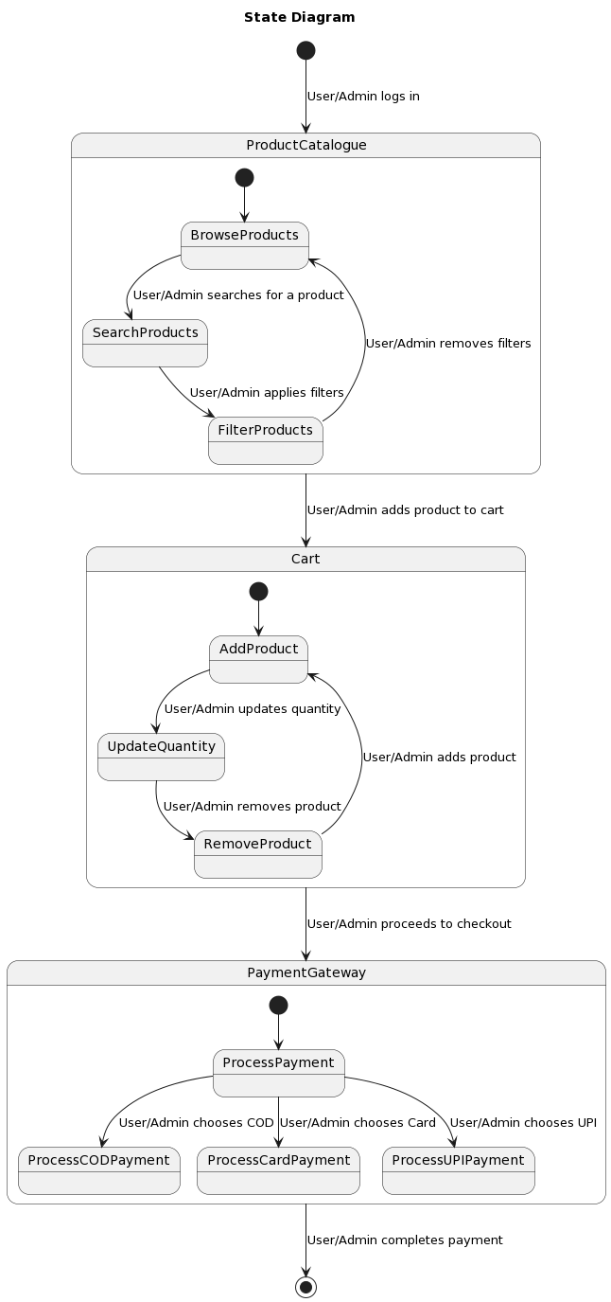
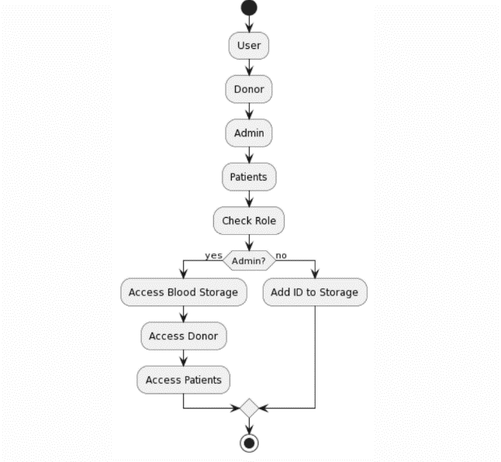
UML Diagrams
Fig. 4.1 Use Case Diagram
Fig. 4.2 Activity Diagram
Fig. 4.3 State Diagram
4

Slide 5
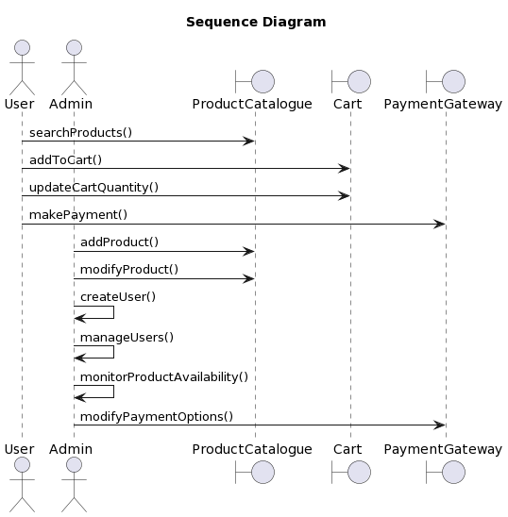
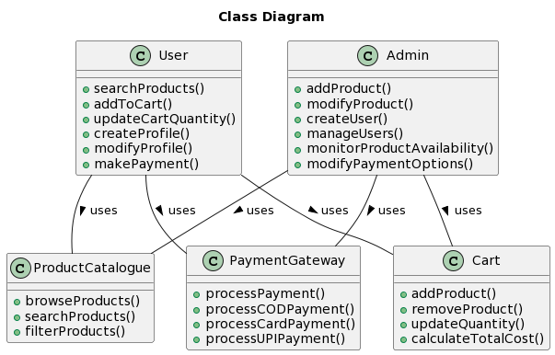
UML Diagrams
Fig. 4.4 Sequence Diagram
Fig. 4.5 Class Diagram

Slide 6
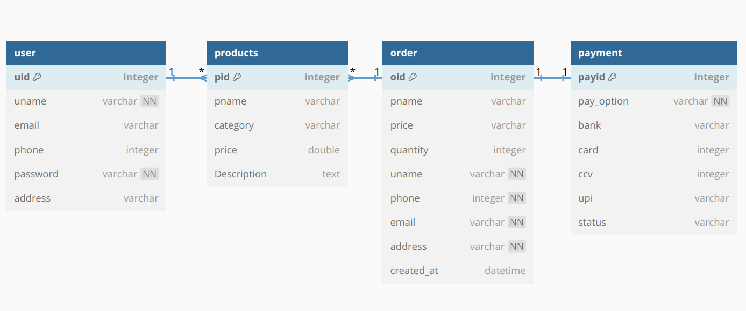
DML Diagram
Fig. 5.1 Data Modeling Layer
6

Slide 7
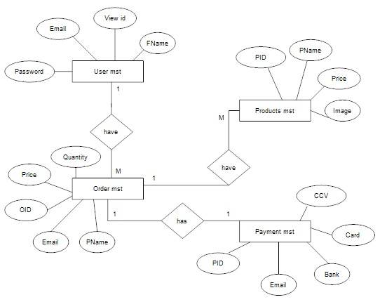
Entity Relationship Diagram
7
Fig. 5.2 ER Diagram

Slide 8
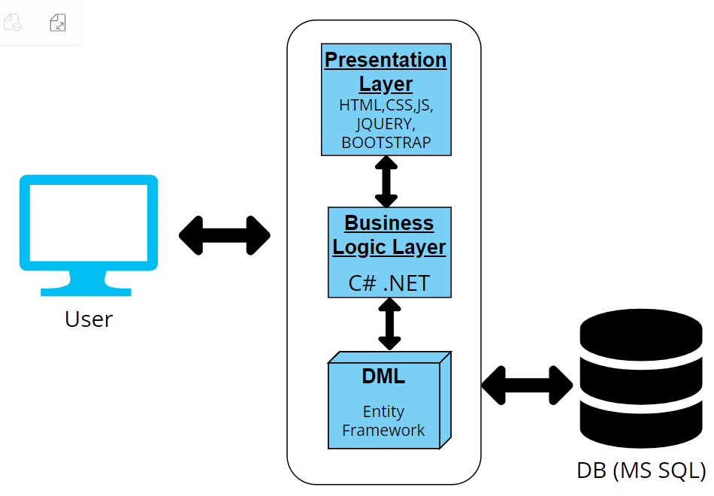
Work Methodology
User: The user interacts with the web application through a web browser, using HTML, CSS, JS, jQuery, and Bootstrap technologies.
Presentation Layer: This layer handles the user interface and presentation logic of the web application, using C# .NET technology.
Business Logic Layer: This layer handles the business rules and functionality of the web application, also using C# .NET technology.
DML (Data Manipulation Language): This layer handles the communication and manipulation of data between the web application and the database, using Entity Framework technology.
DB (MS SQL): This is the database that stores the data for the web application, using Microsoft SQL Server technology.
Fig. 6.1 Deployment Diagram
8

Slide 9
Thank You
Varun M (2321982)
Programmer Analyst Trainee
Varun.M5@cognizant.com

